Slide 1
DATA DIVERS WALMART ANALYSIS
SUBTITLE GOES HERE
DATE 2023

Slide 2


INTRODUCTION
Data Divers is a specialist data analytics agency hired by the US grocery conglomerate Walmart to provide some insights based on historical data to help their sales and marketing team.
We were given the a dataset that covers the period 4 February 2010 to 1 November 2012, including monthly sales figures, national holidays, and inflation rate.
Notes:
C

Slide 3



TEAM
Data Divers is a new data analytics agency that is providing bespoke solutions for a range of clients.
Adnan Hussain
Data Analysis
& Exploration
Sanduni Kaushalya Data Cleaning & Analysis
Charlie Macnaughton
Visualisation &
Communication
Notes:
C

Slide 4
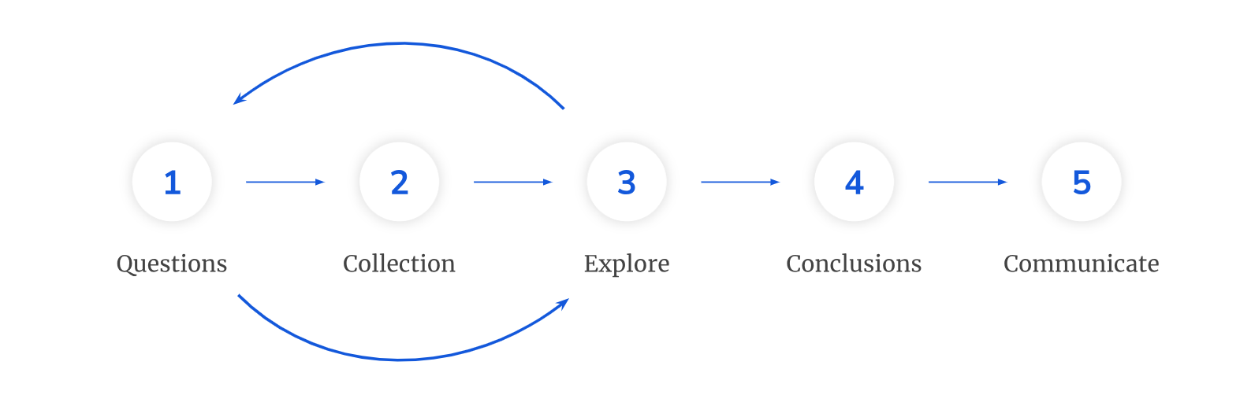
METHODOLOGY
Our team followed a tried and tested methodology based on their experience at the prestigious BrainStation Academy in London under the instruction of Amazon’s Rianna Beaton and Iwoca’s Angela Huang.
Notes:
C

Slide 5
DATA SELECTION & CLEANING
SUBTITLE GOES HERE
DATE 2023

Slide 6
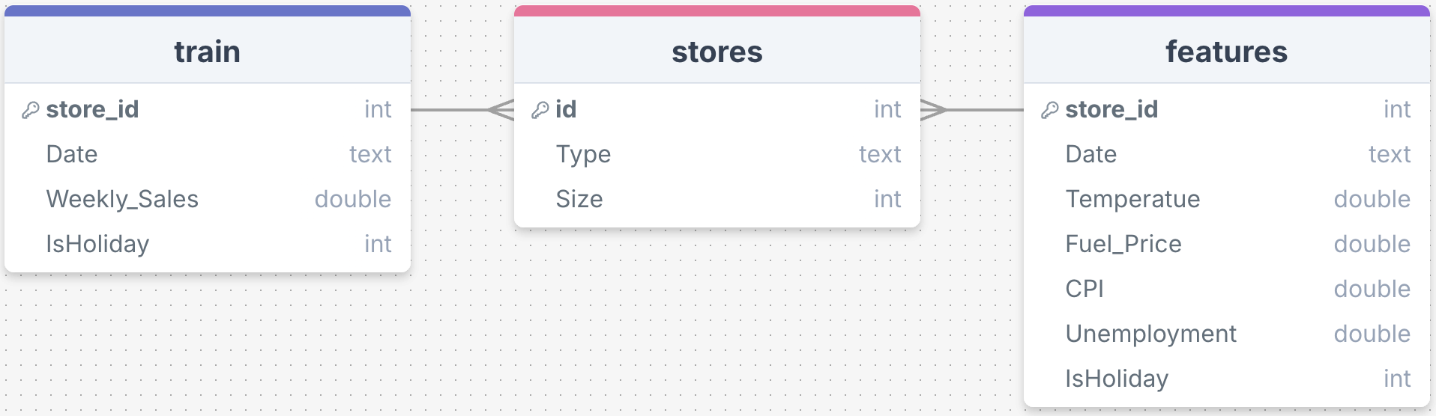
DATA SELECTION
This dataset contains valuable information regarding weekly sales of different Walmart stores in multiple areas across the USA
Contains aspect of human behaviour and potential marketing ideas.
Notable columns include Weekly_Sales, Date, Type and Temperature.
Notes:
A

Slide 7






DATA CLEANING
01
REMOVAL OF UNNECESSARY COLUMNS
HANDLING 'N/A' VALUES
02
03
STANDARDISING HOLIDAY VALUES
04
STANDARDISING NUMERIC DATA
05
CONSISTENT DATA TYPES ACROSS COLUMNS
‹#›
FINAL PROJECT: WALMART | DATA DIVERS 2024
Notes:
S

Slide 8
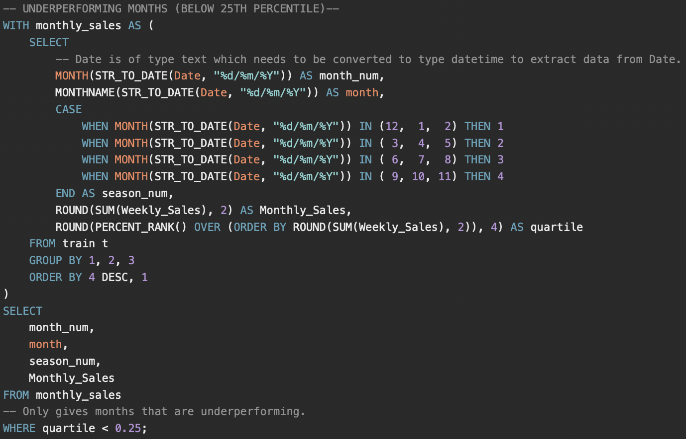
DATA ANALYSIS
A combination of aggregate and window functions were used to calculate averages, quartiles, assemble foreign keys etc.
CTEs were used where appropriate.
STR_TO_DATE was required to change `Date` from type text to datetime.
Quartile analysis was used instead of averages to more accurately highlight extremities.
Notes:
A

Slide 9





QUESTIONS TO CONSIDER
DO CERTAIN TYPES OF STORES PERFORM BETTER THAN OTHERS?
IS THERE A CORRELATION BETWEEN TEMPERATURE AND SALES?
ARE ANY MONTHS SEASONS CONSISTENTLY OUTPERFORMING OR UNDERPERFORMING COMPARED TO THE AVERAGE MONTH/ SEASON?
WHICH HOLIDAYS PERFORM THE BEST FOR A GIVEN WEEK AND WHY?
?
DOES THE SIZE OF THE STORE IMPACT SALES?
IS THERE ADDITIONAL INFORMATION/DATA THAT IS NEEDED TO MAKE FURTHER DECISIONS?
‹#›
Notes:
C

Slide 10
ANALYSIS & INSIGHTS SALES ASSESSMENT
SUBTITLE GOES HERE
DATE 2023

Slide 11
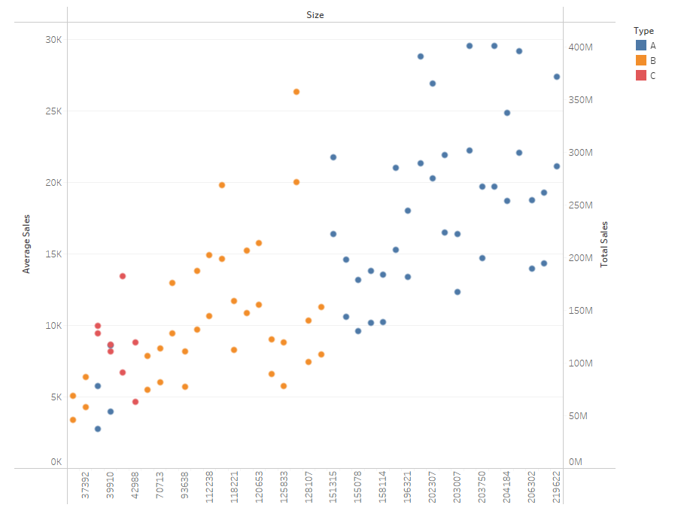
STORE TYPE & SALES
Data included three types of store A,B,C.
Y Axis = Average Sales
X-Axis = Store Size (per sq ft)
Type A (blue) experienced the most sales, with an average of 206m, and is usually the largest at 175K sq ft per store.
Type B (orange) has a size of 101K sq ft with average sales of 117m per store.
C (red) tended to be the smallest at 41K sq ft with average sales of 101m per store.
Notes:
C

Slide 12
STORE TYPE & SALES [2]
Main hypothesis was that:
Greater Size = Greater Sales
We can see that some Type B stores (light blue) see higher sales despite smaller sizes compared to Type A.
Type C also maintained average sales per store similar to Type B despite significant difference in store size. Further investigation required.
Although the size of stores clearly leads to more sales, does this necessarily lead to greater profitability? Need more data.
Notes:
C
Insights:
Type A sees the most sales. Usually this is determined by the size of the store which can be seen on the x axis with a few outliers on the left-hand corner of the chart.
However, there are number of Type B stores which also match that of Type A
Next Steps:
Further analysis should take place to understand how those Type B stores which see high sales have managed to perform as well as Type A.
Although the size of stores clearly leads to more sales, does this necessarily lead to greater profitability? We were unable to ascertain this from the given datasets.

Slide 13
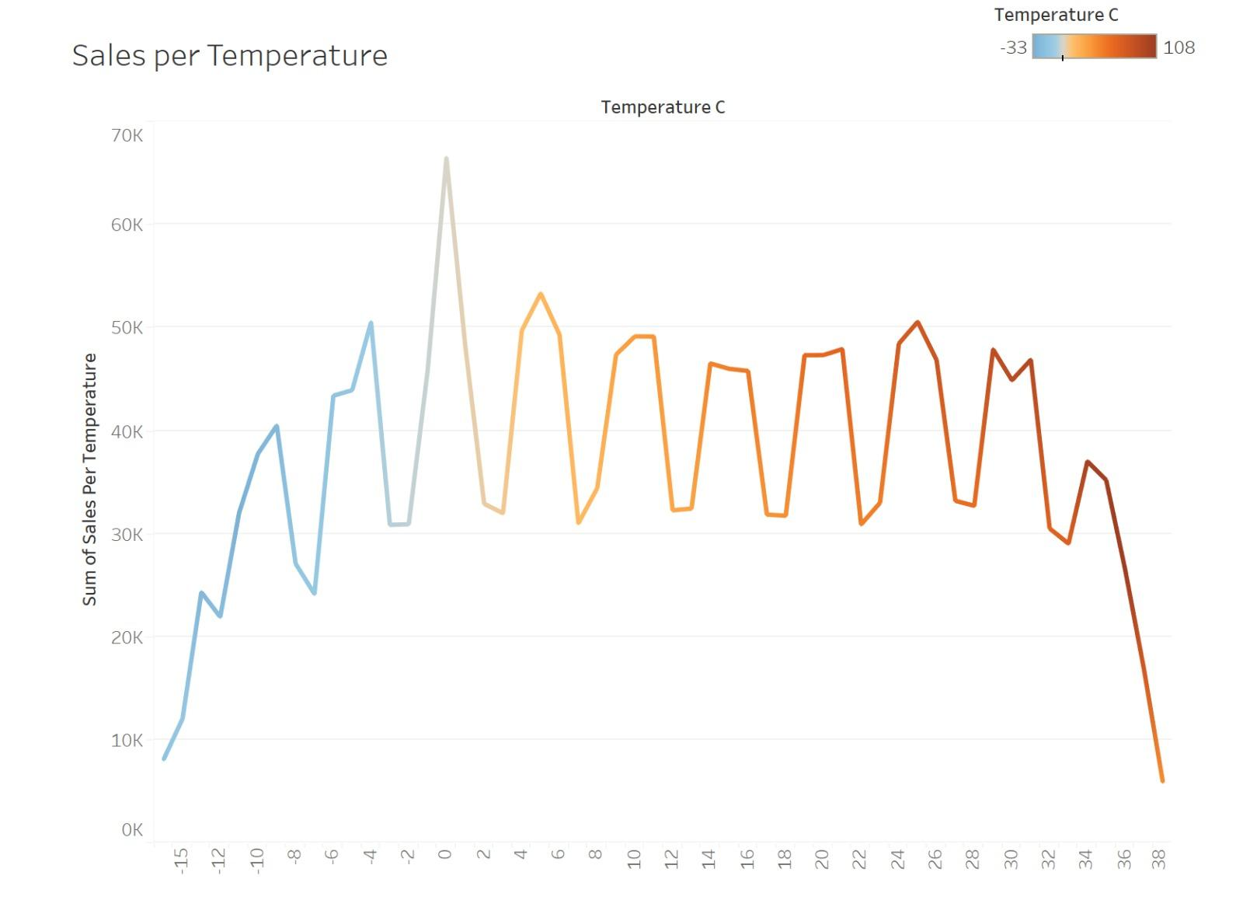
TEMPERATURE & SALES
Highest sales occur at 0 degrees Celsius (32 degrees Fahrenheit). One could argue that customers spend more at this temperature. However, we feel that this correlation does not necessarily suggest causation.
We decided that further analysis would be required to better understand purchasing patterns and consumer behaviour.
Fundamentally, we want to understand whether temperature is a factor in determining higher overall sales.
Notes:
A

Slide 14
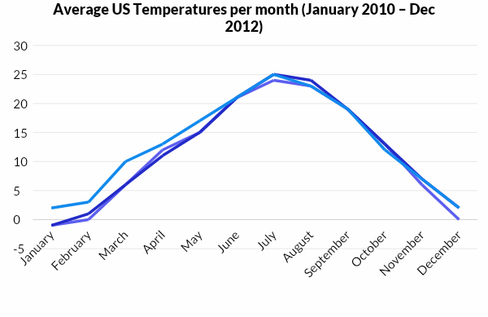
TEMPERATURES & SALES [2]
Average temperatures across the US are around the 0 degrees Celsius mark (32 degrees Fahrenheit).
KEY
2010
2011
2012
2010 2011 2012
January -1 -1 2
February 0 1 3
March 6 6 10
April 12 11 13
May 15 15 17
June 21 21 21
July 24 25 25
August 23 24 23
September 19 19 19
October 13 13 12
November 6 7 7
December 0 2 2
Source: US Average Temperatures by Month (2010-2012), National Centers for Environmental Information
Notes:
A

Slide 15
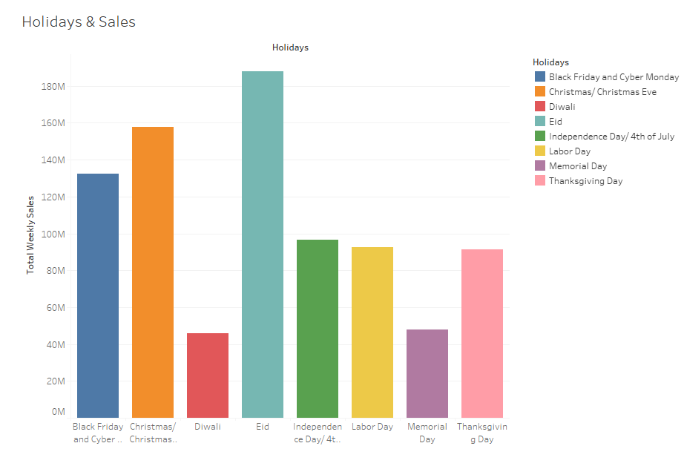
HOLIDAYS & SALES
With this graph, we can see that instead of temperature being the factor on the number of sales, it is that holidays that drive sales.
In the winter months which typically are around 0 degrees Celsius across the United States, this when the major holidays of Christmas and Thanksgiving, which typically involve buying gifts, food, and drink etc.
Notes:
A

Slide 16
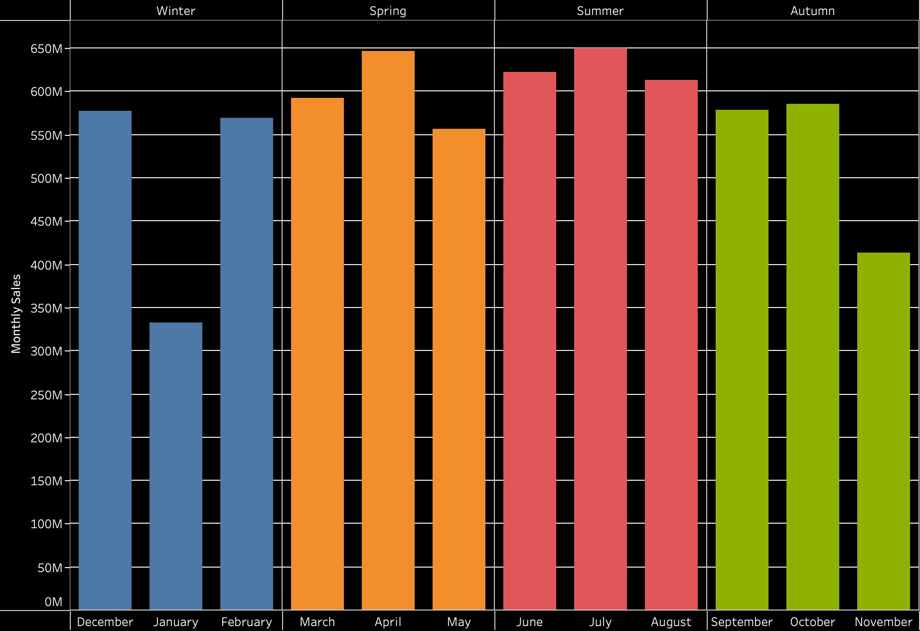
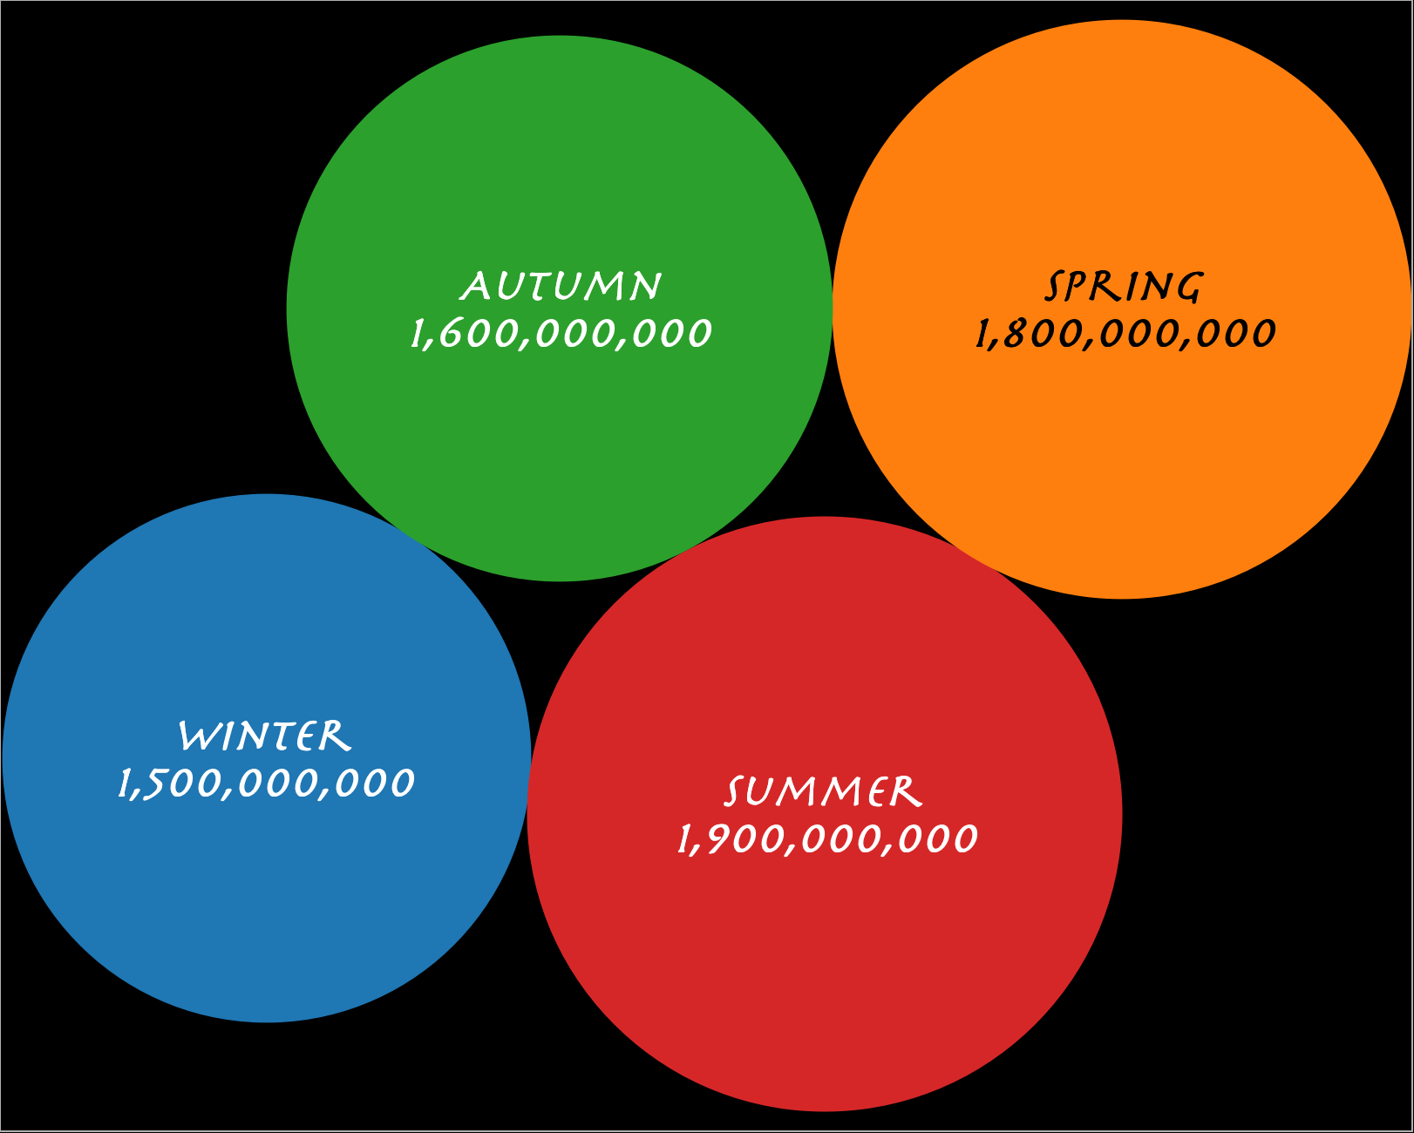
MONTHLY & SEASONAL SALES INSIGHTS
Notes:
S

Slide 17
CONCLUSIONS
RECOMMENDATIONS
SUBTITLE GOES HERE
DATE 2023

Slide 18
KEY RESULTS
Type A | 64%
5% | 0.3bn
6% | 0.4bn
Type A stores contribute the most to sales with averages of 20K.
January average sales
November average sales
19% | 1.3bn
29% | 1.9bn
0.6bn
Sales contribution of underperforming months
Sales contribution of overperforming months
Average Monthly Sales
Notes:
A

Slide 19
NEXT STEPS & RECOMMENDATIONS
Based on our assessment of the provided data, we would suggest the following to Walmart:
RECOMMENDATIONS
Early-Year Promotions: Focus on strong promotional activities from January to April to capitalize on the natural sales increase.
Holiday Focus: Enhance holiday marketing campaigns in December to boost sales further, leveraging the slight recovery seen after the November dip.
Promotional Strategies: Targeted promotions during the January-April growth period and the mid-year stable period can maximize sales, while strategic discounts in November could help mitigate the sales dip.
BUSINESS IMPLICATIONS
Inventory Planning: Walmart should focus on ramping up inventory before peak sales periods like April and maintain steady supply during the mid-year months to prevent stockouts.
Sustain Mid-Year Sales: Maintain consistent inventory and targeted marketing during May to August to sustain the steady demand.
Address November Decline: Investigate the reasons behind the November sales drop and consider strategies like early holiday promotions or special events to boost sales.
Notes:
S

Slide 20
APPENDIX LEARNINGS & LIMITATIONS
SUBTITLE GOES HERE
DATE 2023

Slide 21
LEARNINGS & LIMITATIONS
Type and Sales: It was not clear what type represented (A,B,C), it seems to relate to size but the
Lower Sales Months: No available data on profit or revenue. Despite lower sales, those quieter months of January and November could actually perform well for Walmart.
No Use of Inflation & Unemployment: Not enough supporting data to generate meaningful insights.
Original Dataset: Walgreen dataset was the original dataset but was scrapped due to the small sales time period covered (only a few minutes).
Blank cells: caused problems during SQL analysis and had to be changed to NULL in Excel.

Slide 22
QUESTIONS?
SUBTITLE GOES HERE
DATE 2023

